Slide 1
Parking Management System
CS 5200: Database Management Systems (Spring 2023)
Instructor: Prof. Kathleen Durant
Team: RajaniYPatelD (Yug Deepak Rajani and Dhruv Patel)

Slide 2
Technologies (CLI-based application)
Python
pymysql
curses
matplotlib
MySQL

Slide 3
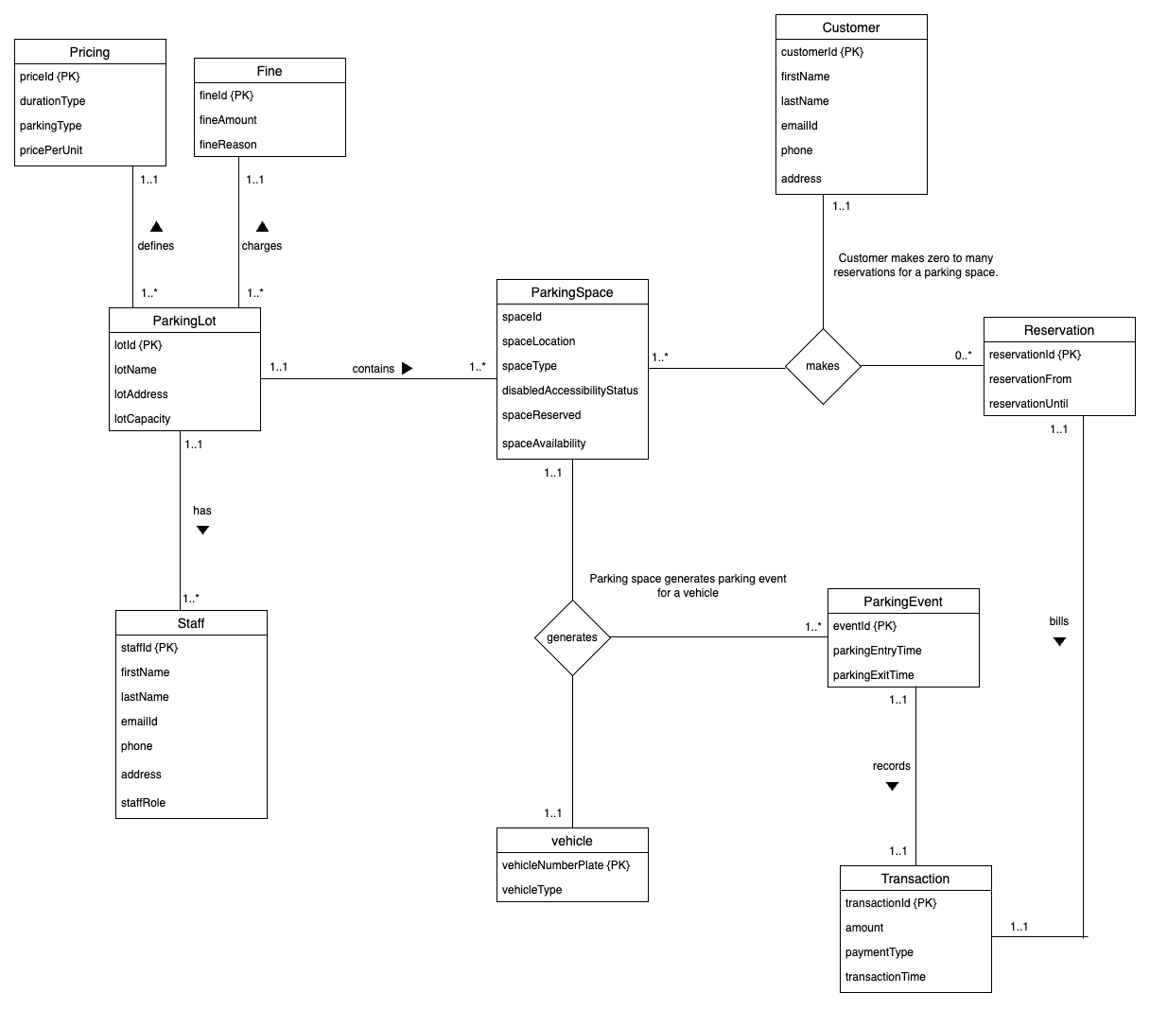
UML

Slide 4
User Roles
Administrator
Manage Parking Lots
Add
Update
Delete
Manage Parking Spaces
Add
Update
Delete
Visualizations of Data
Busiest Hours of Day
Busiest Days of Week
Summarize earnings
Customer
Get a parking spot
With reservation
Without reservation
Generate receipt

Slide 5
Let’s give it a whirl!

Slide 6
Thanks!
Any questions?
Presented by:
Yug Deepak Rajani
Dhruv Patel

